Slide 1
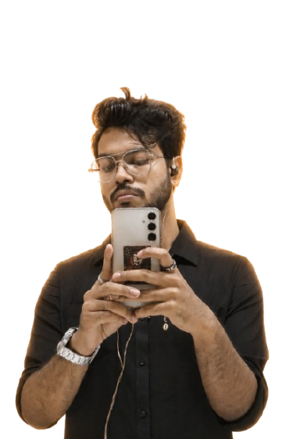
PPPOOORTFOOOLLLIIIOOO
RRTTFF
INDRANIL MAJUMDER
https://github.com/indra1250/indranil-majumder-portfolio

Slide 2
Portfolio Content
TABLE OF CONTENTS
PROFESSIONAL
RESUME
EDUCATION
SUMMARY
PERSONAL SEKILL
CERIFICATIONS
INTERNSHIPS
RESEARCH
INCUBATION (RI)
PROJECTS
SIP
COMPETITIONS AND VOLUNTEERING
CONTACT
THANK YOU

Slide 3
PROFESSIONAL SUMMARY
Aspiring to build a career in analytics-led marketing, business strategy, and techno-commercial roles. I aim to combine marketing expertise with data-driven decision-making to solve business problems and create measurable impact. I possess strong analytical, quantitative, and marketing capabilities, supported by proficiency in SQL, Python, Power BI, Tableau, Excel, and Databricks. My expertise includes market research, B2B marketing, brand management, key account management,
digital strategy, and project management. I am skilled at translating complex data into actionable insights and identifying opportunities across customer, sales, and digital funnels. Currently pursuing a PGDM in marketing at JAGSoM, I have gained practical exposure to sales, marketing, and social media analytics. At Unschool, I analysed lead-conversion funnels to support business growth. At The Yellow Submarine, I contributed to content and brand strategy development. At The 4th Axis, I used social media performance and market research insights to support strategic recommendations. Through certifications and guided projects in data analytics, Agile/Scrum, SEO, CRM, cloud computing, Azure, Databricks, and project management, I am prepared to contribute at the intersection of marketing, analytics, technology, and business strategy.
INDRANIL MAJUMDER
https://github.com/indra1250/indranil-majumder-portfolio

Slide 4
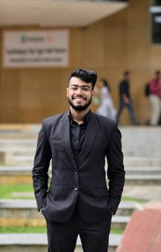
RESUME
INDRANIL MAJUMDER
A final-year PGDM Marketing student at JAGSoM (Batch 2025–27), building a career at the intersection of analytics-led marketing, business strategy, and techno-commercial roles. He combines marketing expertise with data-driven decision-making — backed by hands-on proficiency in SQL, Python, Power BI, Tableau, Excel, and Databricks — to translate complex data into actionable insight across customer, sales, and digital funnels.
Education: PGDM Marketing, JAGSoM (2025–27) | BA, West Bengal State University (70.70%, 2023) | Class XII, WBCHSE (90%, 2020)
Core focus areas: Market research, B2B marketing, brand management, key account management, digital strategy, project management
Internship experience: Unschool (Sales & Marketing, 6 mo) — lead-conversion funnel analysis | The Yellow Submarine (Social Media Marketing, 4 mo) — content & brand strategy | The 4th Axis (Social Media Analyst, 1 mo) — performance analytics & strategic recommendations
INDRANIL MAJUMEDR
https://github.com/indra1250/indranil-majumder-portfolio

Slide 5
RESUME
Beyond coursework, Indranil has applied his marketing-analytics skill set across live and academic ventures — from building e-commerce brands from the ground up to running a full empirical research study on export competitiveness — while building a broad technical and functional toolkit through certifications and guided projects.
Academic & applied projects: Nomad Nibs (digital marketing & e-commerce, 5-member team — LinkedIn brand presence
+ e-commerce site) | Desi Protein (brand management & e-commerce — conceptualized a Desi-flavor protein brand with a dedicated e-commerce site) | Research Incubation — R&D Intensity, Digital Transformation & Export Competitiveness (8,808+ CMIE Prowess firm-year observations, regression modelling, built a Digital Intensity Index)
Guided projects (Coursera): Business Analysis & Process Management, Project Management with ClickUp, Marketing Design with Easil, CRM with HubSpot, Project Management Tracker (Google Sheets), SEO with Squarespace
Technical skills: Python (basic), SQL, HTML/CSS, Power BI, Tableau, Excel, Databricks, ETL pipeline development, Cloud Computing & Microsoft Azure, MySQL/PostgreSQL
Marketing & growth tools: SEO (SEMrush, HubSpot), Meta Business Suite, Git/GitHub, Agile/Scrum
Key certifications: Data Science with AI (PW Skills), Python Essentials 1 & 2 (Cisco), Agile Scrum (Simplilearn), Data Analytics Essentials (Cisco), Cloud Computing & Azure (IBM SkillsBuild, Simplilearn), CRM Systems (OnePageCRM, Simplilearn), SEO (HubSpot, SEMrush), SQL (Simplilearn), Databricks (Simplilearn)
Leadership & involvement: Member, PR and Media Committee (JAGSoM Student Council) | Content Writer, PRARAMBH (JAGSoM's Magazine Team)
INDRANIL MAJUMEDR
https://github.com/indra1250/indranil-majumder-portfolio

Slide 6
EDUCATION
2027
Jagdish Sheth School of Management (JAGSoM)
Pursuing a PGDM in Marketing at JAGSoM, Bengaluru, building capability across analytics-led marketing, brand strategy, and business decision-making.
2023
West Bengal State University
2020
Habra High School (H.S.)
Completed a Bachelor of Arts (General) — 70.70%, with coursework spanning fine/studio arts, history, political science, and English literature, alongside active involvement in the drama club and football team.
Completed Higher Secondary Education (Science - PCM) under WBCHSE — 90%, building the
analytical foundation carried into later academic work.
INDRANIL MAJUMEDR
https://github.com/indra1250/indranil-majumder-portfolio

Slide 7
PERSONAL SKILLS
·Programming & Data Analysis: Python (basic), SQL, HTML, CSS
Creative Presentation
·Analytics & BI Tools: Power BI, Tableau, MS Excel, Databricks, Databricks
·Data Engineering: ETL Pipeline Development, Cloud Computing, Microsoft Azure
·Marketing & Growth Tools: SEO (SEMrush, HubSpot), Meta Business Suite,
·Project & Collaboration Tools: Git, GitHub, Agile/Scrum Databases: MySQL Server, PostgreSQL
INDRANIL MAJUMEDR
https://github.com/indra1250/indranil-majumder-portfolio

Slide 8
Creative Presentation
CERTIFICATIONS
Data Science with AI — PW Skills
Python Essentials 1 and Essentials 2 — Cisco
Agile Scrum Certification — Simplilearn
Data Analytics Essentials — Cisco
ADFAP — Tally Academy
General English Course (Speaking, Writing, Effective Listening) — British Council
SEO Certified — HubSpot Academy
SQL — Simplilearn
Facebook Marketing and Advertising (Meta Business Suite) — Simplilearn
Content-led SEO — SEMrush Academy
Advanced SEO Tool Optimization — SEMrush Academy
Cloud computing & Azure – IBM SkillBuild, Simplilearn
CRM System – OnePageCRM, Simplilearn
Project Management – Coursera(Google)
Databricks – Simplilearn
INDRANIL MAJUMEDR
https://github.com/indra1250/indranil-majumder-portfolio

Slide 9
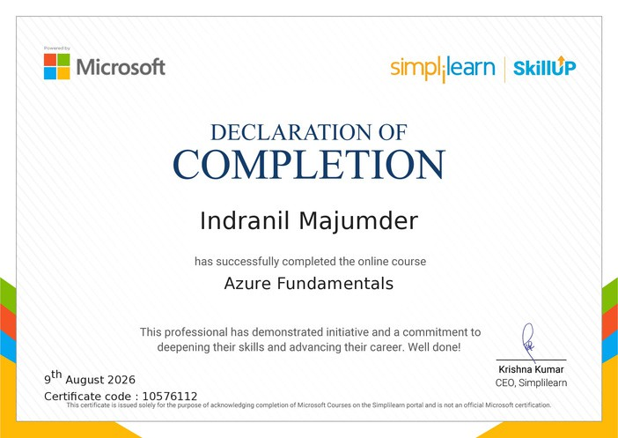
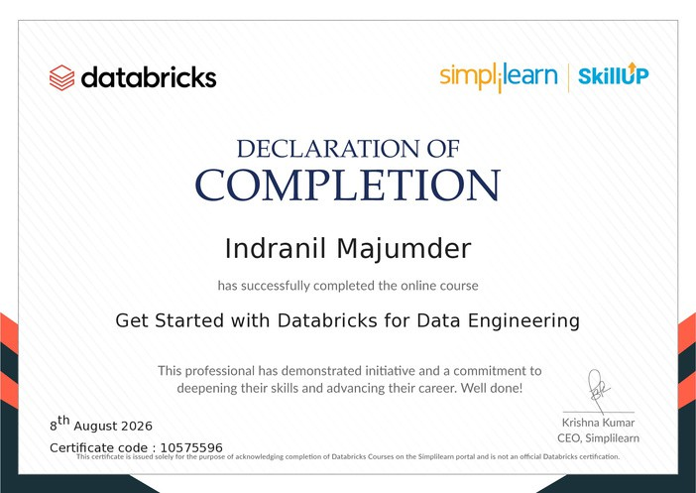
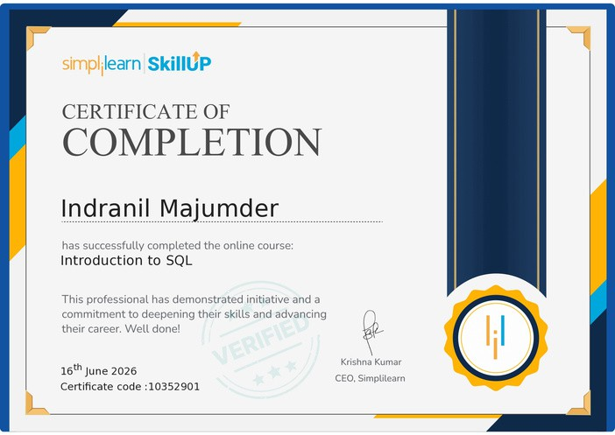



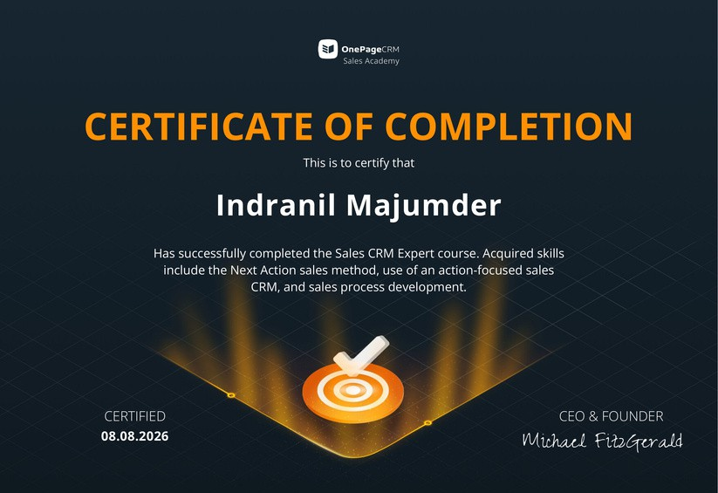
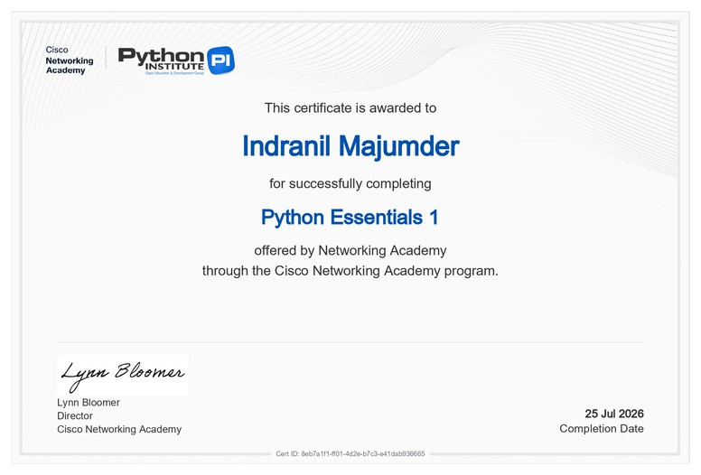
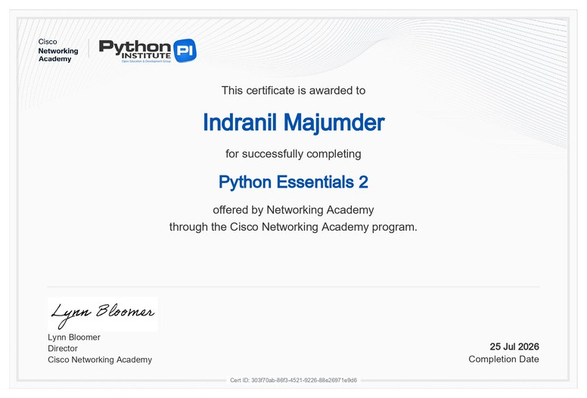



SOME OF THE IMPORTANT CERTIFICATES
Azure Fundamentals — Simplilearn | Microsoft Successfully completed an online course covering core Azure cloud concepts and foundational Microsoft Azure services.
Get Started with Databricks for Data Engineering — Databricks | Simplilearn Completed foundational training in Databricks for data engineering, covering core concepts and practical data engineering workflows.
Introduction to SQL — Simplilearn | SkillUp Completed foundational training in SQL, developing skills in
database concepts, querying, and data manipulation.
Sales CRM Expert Certification — OnePage CRM Sales Academy Certified in the Next Action sales method, action-focused sales CRM usage, and sales process development.
Python Essentials 1 & 2 — Cisco Networking Academy & Python Institute Certified in core Python programming fundamentals through advanced concepts, via the Cisco Networking Academy program.
Python Essentials 1 & 2 — Cisco Networking Academy & Python Institute Certified in core Python programming fundamentals through advanced concepts, via the Cisco Networking Academy program.

Slide 10
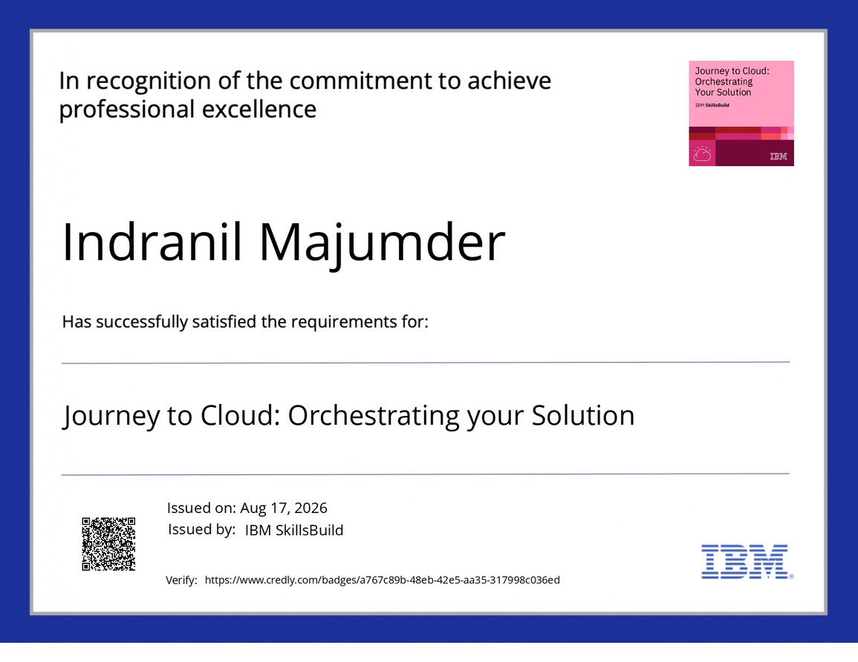

SOME OF THE IMPORTANT CERTIFICATES
Journey to Cloud: Orchestrating Your Solution — IBM SkillsBuild (Issued Aug 17, 2026)
Certified in designing and orchestrating end-to-end cloud solution deployments as part of IBM's cloud learning path.
Cloud Computing Fundamentals — IBM SkillsBuild (Issued Aug 17, 2026) Certified in foundational cloud computing concepts and principles through IBM's SkillsBuild program.

Slide 11
Creative Presentation
INTERNSHIPS
Sales and Marketing (Intern) 2022 Unschool
Identified and qualified prospective learners through outbound calls and messaging, contributing to lead generation efforts for the platform's course offerings.
Assisted in executing digital marketing campaigns across social media and email channels, supporting increased visibility and engagement for course
Tracked and analyzed lead conversion data to identify drop-off points in the sales funnel, providing insights to improve outreach strategy.
Collaborated with the sales team to refine pitch messaging and follow-up processes, contributing to a more consistent and effective enrollment conversion.
Social Media Marketing (Intern) 2026 The Yellow Submarine
Developed and executed social media content calendars for client brands, aligning post themes with each brand's identity and target audience.
Conducted competitor and market research to inform content strategy, helping identify positioning gaps and content opportunities for client accounts.
Created and refined brand messaging and visual content guidelines, ensuring consistency across client social media platforms.
Compiled a comprehensive internship report analyzing campaign performance and social media strategy, translating insights into actionable recommendations.
Social Media Analyst (Intern) 2026 The 4th Axis
Monitored and analyzed social media performance metrics (engagement, reach, follower growth) across the brand's content, identifying trends among Bengali-speaking audiences.
Conducted community engagement and digital outreach to strengthen audience interaction and brand presence on social platforms.
Performed market research on regional digital media trends, providing strategic recommendations to improve content relevance and audience retention.
Compiled analytics reports summarizing content performance, translating data into actionable insights that informed the brand's ongoing content strategy.
INDRANIL MAJUMDER
https://github.com/indra1250/indranil-majumder-portfolio

Slide 12
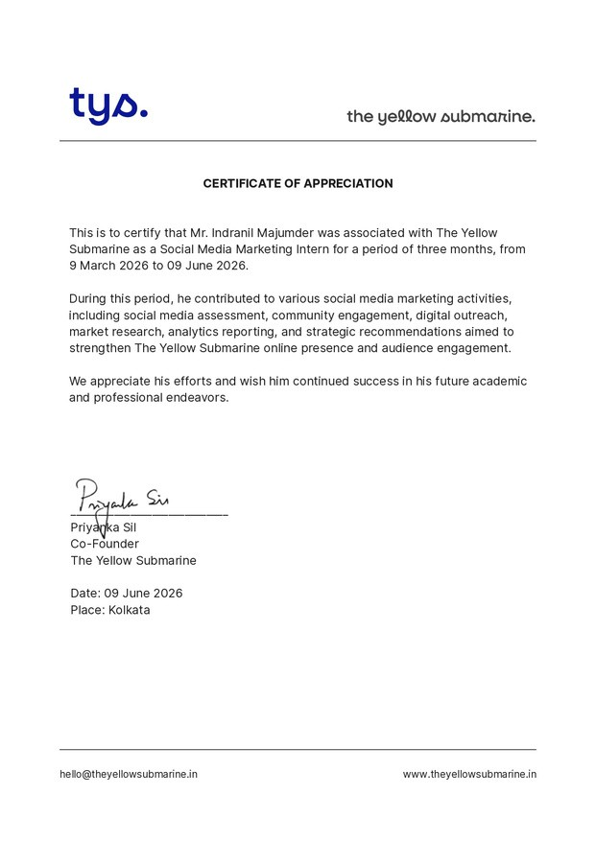
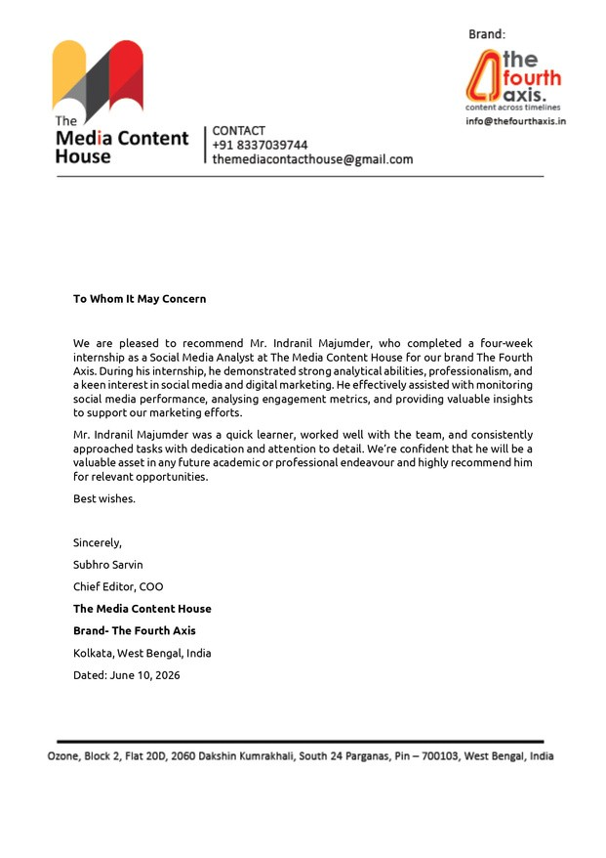


INTERNSHIPS
INTERNSHIP CERTIFICATES
Certificate of Appreciation — The Yellow Submarine (Mar–Jun 2026) Recognized as Social Media Marketing Intern for contributions across social media assessment, community engagement, digital outreach, market research, analytics reporting, and strategic recommendations.
Letter of Recommendation — The Media Content House (Brand: The Fourth Axis), Kolkata
Completed a 4-week internship as Social Media Analyst, recognized for strong analytical ability and effective support in monitoring performance, analysing

Slide 13
PROJECT
Business Analysis & Process Management – Coursera(guided) Introduction to Project Management with ClickUp – Coursera(guided) Marketing Design with Easil – Coursera(guided)
Introduction to CRM with HubSpot – Coursera(guided)
Create a Project Management Tracker using Google Sheets – Coursera(guided) Search Engine Optimization (SEO) with Squarespace – Coursera(guided)
ACADEMIC PROJECT (1)
Nomad Nibs — Digital Marketing & E-commerce Project | 2026
Worked as part of a five-member team to develop the brand’s digital presence.
Created and managed the Nomad Nibs LinkedIn page to support brand communication and visibility. Contributed to the development of an e-commerce website for palm-oil-free and vegan chips.
Project Link: https://www.nomadnibs.in/
ACADEMIC PROJECT (2)
Desi Protein — Brand Management & E-commerce Project | 2026
Conceptualized a digital-first protein brand offering products inspired by Indian/Desi flavors and consumer preferences. Developed an e-commerce website focused on brand positioning, product presentation, and customer experience.
Applied digital marketing, consumer behavior, branding, and e-commerce principles to translate the concept into a cohesive digital business proposition.
Project Link: https://desiprotein-preview.preview.emergentagent.com/
INDRANIL MAJUMDER
https://github.com/indra1250/indranil-majumder-portfolio

Slide 14
SOCIAL IMMERSION PROGRAM (SIP)
As part of JAGSoM's Social Immersion Programme (SIP) — a mandatory field-based capstone in the PGDM Marketing curriculum — I led a marketing and analytics-driven intervention for Prime Educational and Social Trust, a grassroots NGO in Puducherry running the Janani Home for Girls shelter and several community education initiatives. Over a 10-day, on-ground engagement with Group 10, we diagnosed why a genuinely high-impact organisation was struggling to convert its ground-level work into donor visibility and funding, and then designed and delivered a self-sustaining digital operating system the Trust could run on its own long after we left. This case study captures the problem, my approach to diagnosing and solving it, what I personally built, and what it demonstrates about my capability in marketing strategy, data-driven decision-making, and stakeholder-centred execution.
The structural problem: Grassroots NGOs in India operate under a "capability-visibility gap" — organisations doing meaningful frontline work (shelters, tailoring centres, evening schools) simply don't have the bandwidth or in-house digital expertise to communicate that work convincingly to funders.
Diagnostic findings from our situation analysis:10 active fundraising projects on GlobalGiving were static and rarely updated, causing weak international donor conversion
Instagram and Facebook presence existed but posted irregularly with no cohesive brand narrative, missing younger, digitally-native donors and volunteers
Student and beneficiary data for evening schools lived in fragmented manual spreadsheets, slowing CSR audit reporting and increasing error risk
No repeatable process existed for identifying or approaching CSR departments across Puducherry and Tamil Nadu — outreach was reactive, not strategic
Four-pronged problem definition: Fragmented Digital Presence, Operational Data Silos, Non-Standardised CSR Outreach, and — the most strategically important insight — Knowledge Perishability: every past intern or volunteer brought temporary digital skills that left with them, leaving Prime Trust structurally incapable of compounding its digital capability over time.
INDRANIL MAJUMDER
https://github.com/indra1250/indranil-majumder-portfolio

Slide 15
(SIP) - CONTINUATION
Rather than defaulting to the obvious short-term fix — simply managing the NGO's social accounts for the visit's duration — I pushed the team toward a solution architecture that would outlive our presence. We evaluated three alternatives through a formal Techno-Economic Viability (TEV) framework, scoring each on technical feasibility and economic viability so the recommendation to the Trust and to JAGSoM was evidence-based rather than opinion-based — a structured, quantified decision-making approach I now default to whenever choosing between marketing initiatives with competing resource claims.
Alternatives evaluated: Direct Content Management (fast but purely temporary; scored lowest on sustainability) · Professional Content Production (technically sound, economically unviable for the Trust) · Sustainable Capacity Building (recommended) — durable, transferable assets: a social media handbook, CSR proposal templates, automated Excel dashboards, and video tutorials. Scored 92/100 on the TEV matrix, driven by zero capital expenditure, zero recurring cost, and direct resolution of the knowledge-perishability root cause.
The final solution — Prime Trust Digital Empowerment Suite (bundling all three evaluated options so capacity-building, revenue generation, and brand visibility were addressed simultaneously):
Skill Tutorial Video Library — 10+ screen-capture tutorials on Excel (donor/student data management), PowerPoint (donor presentations), and Canva (social content), built entirely on tools already on the NGO's hardware
AI Usage Guide for NGO Staff — practical training on ChatGPT and Perplexity for drafting reports, newsletters, and donor correspondence, positioning AI as a force multiplier for a two-person admin team
CSR Outreach Toolkit — a structured SOP and contact database for CSR departments across Puducherry and Tamil Nadu, with proposal templates for all 10 of the Trust's projects, aligned to Section 135 of the Companies Act
Instagram Content Strategy & Social Media Handbook — a storytelling-first framework with ready-to-edit Canva templates, shifting content from generic "event photos" to donor-resonant "impact stories," designed for staff to run independently with free tools
Measured impact: delivered a fully TEV-scored recommendation (92/100) rather than unstructured suggestions · converted an ad-hoc, founder-dependent presence into a documented, repeatable system · produced ready-to-send CSR proposals for all 10 live projects, each meeting statutory compliance · embedded AI into daily NGO operations at zero cost · received a formal Letter of Appreciation from Prime Trust, with the project's LinkedIn reflection featured in JAGSoM's SIP 2026 cohort showcase. Because the intervention required zero capital expenditure and zero recurring cost, its impact is structurally durable — the Trust's digital capability doesn't degrade once the 10-day window closes.
INDRANIL MAJUMDER
https://github.com/indra1250/indranil-majumder-portfolio

Slide 16
(SIP) - CONTINUATION
This project reshaped how I think about the purpose of marketing. Working directly with the children at Janani Home for Girls — including facilitating a sensitive "Good Touch and Bad Touch" awareness session — and watching women at the Akshaya Tailoring Centre build livelihood skills made the stakes of "visibility" tangible in a way no classroom case study could. It reframed a well-structured Instagram post or an automated data sheet not as a marketing deliverable, but as the mechanism by which a child receives a scholarship or a school gets a roof — a shift from marketing-as-commercial-tool to marketing-as-instrument-of-access that I now carry into every subsequent brief.
Strategic & Analytical: structured problem framing via situation analysis and root-cause breakdown · TEV analysis to quantitatively compare competing strategic options · translating a resource-constrained brief into a scoped, deliverable-based architecture
Marketing & Communications: content strategy and storytelling frameworks tailored to donor acquisition · CSR proposal writing aligned to statutory compliance · stakeholder communication across NGO staff, children, and corporate CSR contacts
Data & Tools: Excel-based data management and dashboard automation · applied use of AI tools (ChatGPT, Perplexity) for operational efficiency · non-designer-friendly Canva template systems built for handover and reuse
Leadership & Execution: field-based execution under a fixed 10-day timeline · knowledge-transfer design built for sustainability and independence rather than short-term service delivery
Key learnings: marketing = access, not just promotion · diagnose root causes, not symptoms · structured decisions beat gut calls · design for sustainability, not just delivery · treat constraints as design inputs · adoption depends on simplicity · match format to how people learn · ground-level exposure builds real conviction · honesty about limitations builds credibility
INDRANIL MAJUMDER
https://github.com/indra1250/indranil-majumder-portfolio

Slide 17
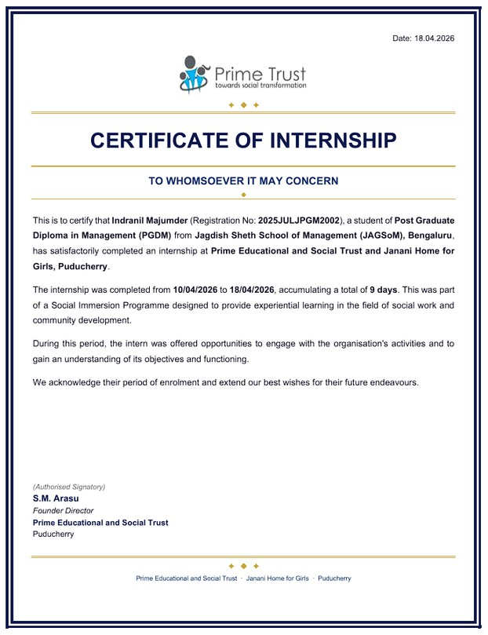
CERTIFICATE OF SIP
Certificate of Internship — Prime Educational and Social Trust & Janani Home for Girls, Puducherry (10–18 Apr 2026)
Completed a 9-day Social Immersion Programme internship as part of JAGSoM's PGDM curriculum, gaining experiential exposure to the Trust's social work and community development activities.
Completed a 9-day Social Immersion Programme internship as part of JAGSoM's PGDM curriculum, gaining experiential exposure to the Trust's social work and community development activities.
INDRANIL MAJUMDER
https://github.com/indra1250/indranil-majumder-portfolio

Slide 18
RESEARCH INCUBATION(RI)
As part of my Research Incubation project at JAGSoM (mentored by Dr. Banantika Datta), I designed and ran a firm-level empirical study on R&D Intensity, Digital Transformation, and Export Competitiveness: Evidence from Indian Firms. The core question carries real strategic weight for Indian industry and policy: do R&D spending and digital infrastructure investment actually make Indian firms more competitive exporters, or is export success driven by more structural factors — the industry a firm sits in, its supply chain, and its people? Using eleven years of firm-level financial data from the CMIE Prowess database (2014–2025), I built and estimated seven regression models to test this rigorously rather than anecdotally, filling a genuine literature gap — no prior study had combined a composite Digital Intensity Index with R&D and royalty-licensing data to compare their effects before and after the COVID-19 digital-adoption shock.
RQ1: Are R&D intensity and technology-licensing (royalty) payments associated with export volume, intensity, participation, and service-export likelihood — and is this effect stronger in technology-intensive sectors (electronics, software, R&D services)?
RQ2: Is a composite Digital Intensity Index (software, IT-enabled services, ISP, data centre, satellite/VSAT costs) associated with export intensity and participation — and does this differ between manufacturing and services firms?
INDRANIL MAJUMDER
https://github.com/indra1250/indranil-majumder-portfolio

Slide 19
RI - CONTINUED
Rather than relying on a single regression, I built a battery of seven models spanning OLS (continuous outcomes) and logistic regression (binary outcomes), each with industry fixed effects at the two-digit NIC level. I cleaned 9,281 firm-year observations from an original pull of ~38,000, split the sample into pre-pandemic (2014–2019) and post-pandemic (2020–2025) periods, and constructed the Digital Intensity Index by standardising five spend categories into z-scores to avoid multicollinearity. The most important discipline throughout was following the data even when it contradicted the popular "innovation drives exports" narrative — several hypotheses did not hold up, and reporting that honestly mattered more than forcing a tidier story.
Findings that held up: R&D spending positively linked to export volume post-pandemic (1% rise in R&D →
~0.06% rise in exports, p = 0.002) · sectoral identity mattered enormously (pharma, apparel, food & beverages, chemicals exported significantly more; construction significantly less) · imported raw material intensity raised export odds by ~5.9% · salary/wage expenditure consistently predicted export participation and service exports Findings that did not hold up: Digital Intensity Index showed no significant link to export intensity or participation in either period · royalty/tech-licensing payments showed no significant export effect · R&D did not pay off more in technology-intensive sectors specifically · digital investment's export effect did not differ significantly between manufacturing and services firms
INDRANIL MAJUMDER
https://github.com/indra1250/indranil-majumder-portfolio

Slide 20
RI - CONTINUED
This project taught me the difference between a plausible story and a defensible one. I expected R&D and digital spending to be the headline drivers of export success — the data pushed back hard, and the more valuable skill built wasn't running the regressions but resisting the urge to spin null results into something they weren't. Sectoral identity, supply-chain integration, and workforce quality mattered more than the "innovation" variables everyone assumes matter most — a genuinely useful, if less flattering, lesson in letting evidence override intuition.
Strategic implications: firms in established export sectors should keep investing in R&D to reinforce existing advantage; those without one need a competitive product first, not R&D alone · supply-chain integration is a faster, cheaper path to export-readiness than large R&D outlays · high digital spend isn't a differentiator by itself — allocation matters more than magnitude · policymakers should favor targeted, sector-aware support over broad R&D subsidies
Skills demonstrated: designing/estimating multiple OLS & logistic models with fixed effects on a 9,000+ observation panel · constructing standardised composite indices · structuring research around a clear literature gap · pre-/post-shock comparative design · transparent reporting of null/contradictory results · translating statistical output into corporate and policy implications
Key learnings: popular narratives don't always survive real testing · being willing to be wrong is part of rigorous research · structural factors often beat the "exciting" variables · statistical significance ≠ real-world relevance · correlation isn't causation — say so plainly · good research ends in a decision, not just a coefficient
INDRANIL MAJUMDER
https://github.com/indra1250/indranil-majumder-portfolio

Slide 21
COMPETITION AND VOLUNTEERING
COMPETITIONS
Aakriti 2k25 — 1st Place Winner
Arihant Institute of Commerce and Management, Bengaluru
Investors Tank — Aakriti 2k25, Arihant Institute of Commerce and Management (Nov 2025) — First Place
Competed in Investors Tank, an investment-pitch competition at Aakriti 2k25, presenting a structured investment case to a panel of judges as part of a 3 member team representing JAGSoM.
Secured first place among participating teams from multiple institutions, demonstrating the ability to build and defend a compelling investment thesis under competitive, time-bound conditions.
Contributed to structuring the investment narrative and articulating the case clearly to a judging panel — combining financial reasoning with persuasive communication.
Represented JAGSoM at an external inter-collegiate platform, reflecting strong analytical and presentation skills valued in finance, consulting, and analytics-driven roles.
Kanyathon
Jagdish Sheth School of Management (JAGSoM), Race Management Department
Volunteered for the student-driven annual charity run.
INDRANIL MAJUMDER
https://github.com/indra1250/indranil-majumder-portfolio

Slide 22




CONTACT ME
Indranil Majumder
indranilhere
@indraquotes02 imajumder349@gmail.com
8250799346
indra1250
INDRANIL MAJUMDER
https://github.com/indra1250/indranil-majumder-portfolio

Slide 23

TTTHHAAANNKKK YOU
YYOOUU
INDRANIL MAJUMDER
https://github.com/indra1250/indranil-majumder-portfolio

